Slide 1

Dashboard Design :
Bank Customer Analytics Dashboard
Thota Ritvika reddy

Slide 2
Dataset & Project Information
📊 Dataset Used
Bank Customer Marketing Dataset
This Dataset Contains Customer Information Such As Age, Job, Marital Status, Education, Account Balance, Loan Details, And Deposit Subscription.
It Helps Analyze Customer Behavior And Financial Patterns.
🎯 Objective of the Task
To design an interactive dashboard for business stakeholders that provides meaningful insights and supports decision-making.
The dashboard focuses on:
Customer distribution analysis
Financial balance insights
Deposit subscription behavior
Customer segmentation

Slide 3
Dataset & Project Information
🛠 Tools Used
Power BI Desktop (Dashboard creation)
Data visualization techniques
Interactive filters (slicers)
KPI cards for summary insights
📈 Dashboard Features
KPI cards showing total customers and financial metrics
Customer segmentation by job, education, and marital status
Balance and deposit analysis
Interactive slicers for dynamic filtering
Clean and professional dashboard design

Slide 4
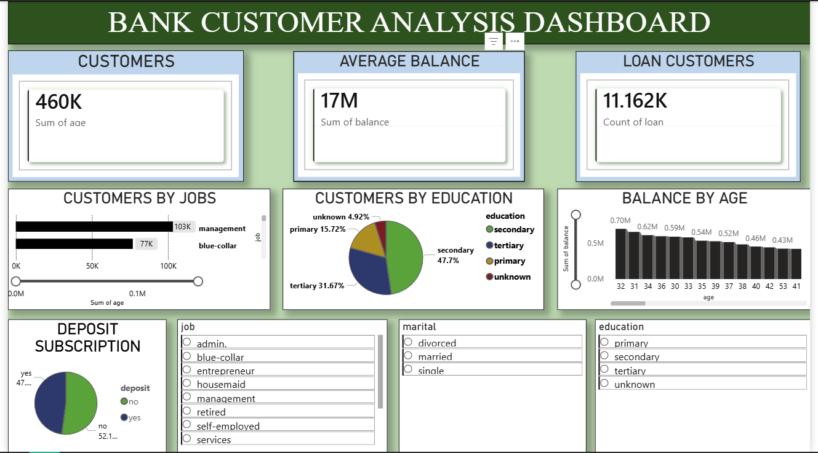

Slide 5
Key Insights from Dashboard
The dataset contains approximately 460K total customers, showing a large and diverse customer base.
The average bank balance is around 17M, indicating overall financial strength of customers.
Around 11K customers have active loans, helping the bank understand loan demand and credit usage.
Most customers belong to job categories like management and blue-collar, which form the major customer segment.
Majority of customers have secondary and tertiary education, showing an educated customer base.
Deposit subscription analysis shows that more customers have not subscribed to term deposits compared to those who subscribed.
Customer balance distribution by age indicates that customers in the 30–40 age group maintain higher balances.

Slide 6
Conclusion
An interactive dashboard was successfully created using Power BI to analyze bank customer data.
The dashboard provides clear insights into customer distribution, financial balance, loan usage, and deposit subscription trends.
KPI cards, charts, and slicers help stakeholders quickly understand customer behavior and financial patterns.
Interactive filters allow users to explore data based on job, education, and marital status.
This dashboard can support the bank in making better marketing, loan, and investment decisions.
Final Statement
This project demonstrates the effective use of data visualization and dashboard design to transform raw data into meaningful business insights for decision-making.

